Slide 1
Briefing Session
“Pocket Drug Counselor” Mobile Apps for Drug Rehabilitation
(Tender reference: ELCSS-HO-EC/BDF 130028/2014)
27 August, 2014
ELCHK Enlighten Centre

Slide 2
Programme
11:00 am | Introduction
11:10 am | Service of Enlighten Centre
11:25 am | Highlights of Tender Document
11:40 am | Q & A
12:00 noon | End of Briefing

Slide 3
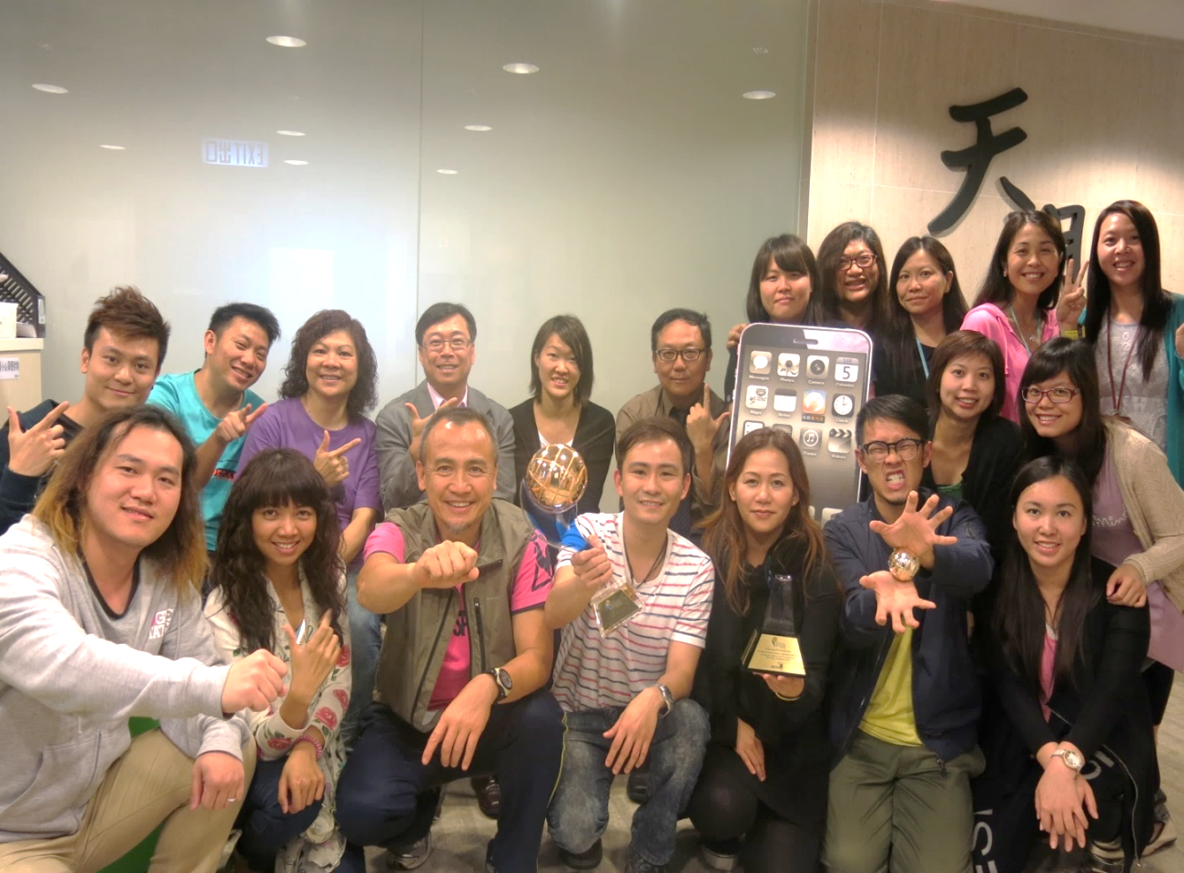
中心架構
_{服務總監}
_{中心主任}
_{社工 8 位}
_{精神科護士}
_{中醫師}
_{計劃主任}
_{行政人員 3 位}
_{輔導幹事 2 位}
_{服務支援 2 位}

Slide 4
服務圈互動策略
服務圈互動策略
_{輔導及家長}
_{為本}
_{社區網絡為本}
_{才藝訓練及}
_{互動劇場為本}
醫療服務及早介入減毒害
靈性牧養及創新手法為本

Slide 5
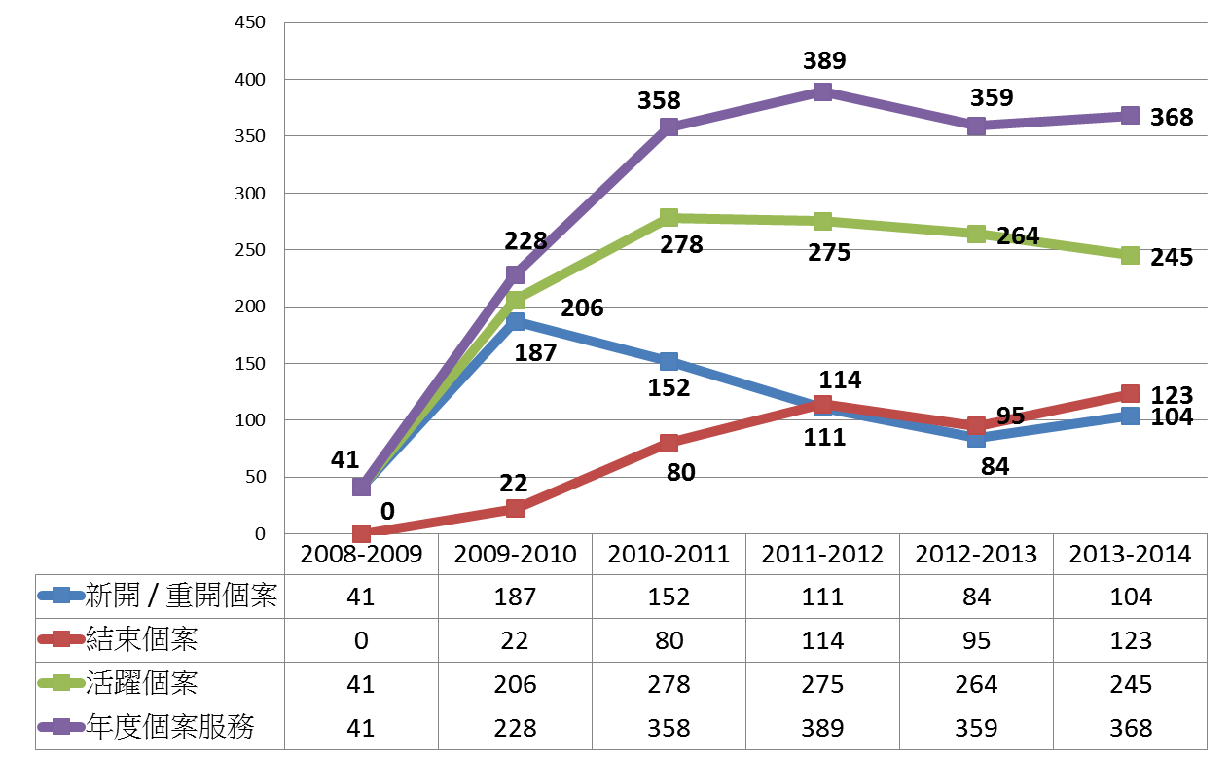
天朗中心個案服務數字統計

Slide 6
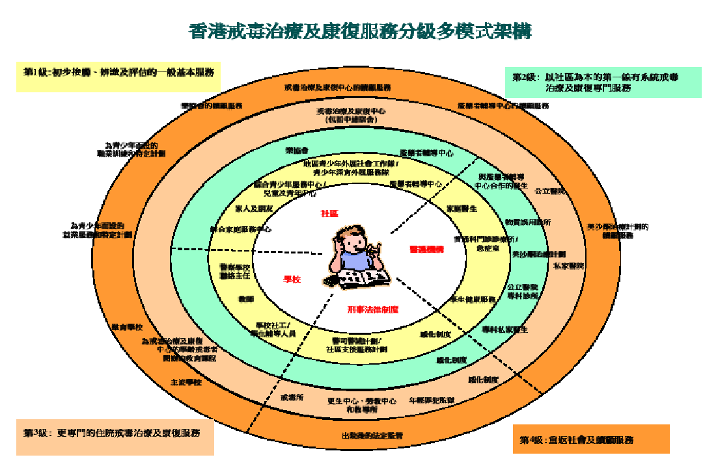
社區為本 – 探索『社區戒毒』模式
_{短期戒毒營}

Slide 7
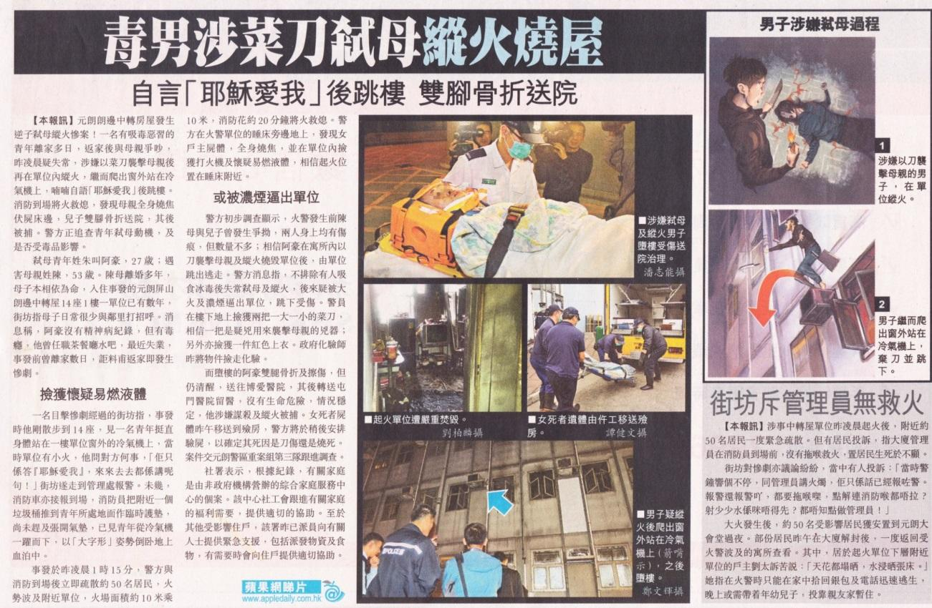
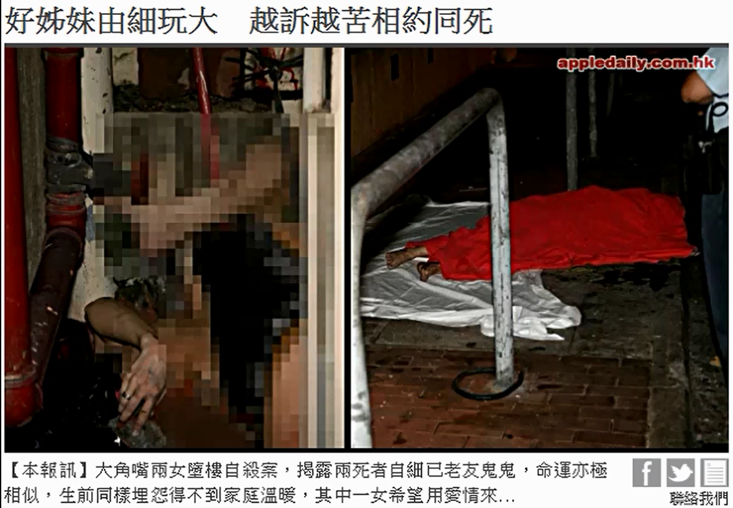
2014/3/17 朗邊中轉屋--蘋果日報
2014/8/7 蘋果日報

Slide 8
天朗中心吸毒求助個案數據分析

Slide 9
天朗中心吸毒求助個案數據分析

Slide 10
天朗中心吸毒求助個案數據分析

Slide 11
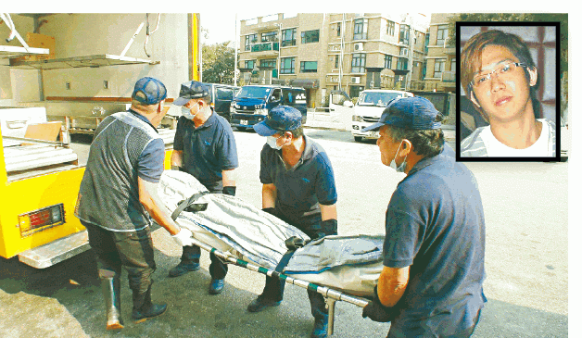
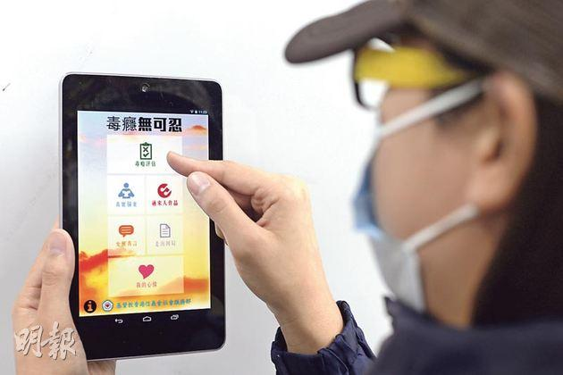
坤媽指責你哋一D嘢都做唔到阿…
天朗最近面對的無奈/助/能感
我們可做的都盡力去做，遺憾…
24/10/2014一名曾向天朗求助27歲男子暈倒在住所浴室內，救護員到場已證實死亡；警方事後在現場檢獲少量毒品及吸食工具

Slide 12
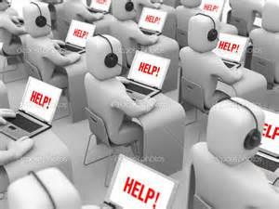
製作第二代智能手機程式 – 理念
An innovative path for providing help
Reduce client’s ambivalence
Enhance the motivation of help seeking behavior
Notes:
An innovative path for providing help
Reduce client’s ambivalence
Enhance the motivation of help seeking behavior
*

Slide 13
Implementation Schedule
20/08/2014 Open of Tender
27/08/2014 Tender Briefing
10/09/2014 Closing Submission of Tender (by 2:00p.m.)
15-19/09/2014 Tender interview

Slide 14
3.2 Pocket-Drug-Counselor (PDC)
Pocket-Drug-Counselor (PDC) is a multimedia counseling-like mobile application(s) that is/are an extension of drug-addiction counseling service, with advanced smartphone technology. Contractors are required to propose different individual mobile app/apps and design of appropriate clinical intervention content and structures to achieve each of these requirements.

Slide 15
3.3 Key features requirements of PDC:
The Apps proposed should have at least:
Android (support Android 4.0 or above) and
iOS (support iOS 6.0 or above, fits both Iphone 4 or above and Ipads resolutions) versions
Windows Mobile 8 or other versions are optional

Slide 16
3.4.1 Goal of PDC
Encourage the hidden drug abuser to seek help via PDC
shorten the “hidden period”
According to the CRDA, average hidden period of drug abusers is 5 years
to use PDC to enhance drug abusers’ awareness and sensitivity towards the impacts of drug and to reduce their negative emotions via PDC.

Slide 17
3.4.2 PDC is required to use creative and effective ways to reach out to the target population with least effect on stigmatization, and to promote help-seeking behavior.
3.4.3 Intensity or the level of PDC counselor’s intervention is subject to drug abusers’ option. For people with different symptoms, they should be guided and/or encouraged by the App for entering into different levels, or step by step, for further assistance gradually.
3.4.4 All data, including drug usage, patterns and distribution of addiction symptoms of the target community, are to be collected, saved in the Pocket Drug Counselor System for overall analysis purpose.

Slide 18
3.4.5 PDC is required to base on the principles of Brief Intervention (BI) and its FRAMES model (or any equivalent and industry validated and reliable model that serve the same function as below):
Feedback: Give feedback on the risks and negative consequences of drug users with a vivid and valid assessment of addiction.
Responsibility: Emphasize that the individual is responsible for making his or her own decision about his/her drug-taking behavior. Self-control is highly associated with sense of responsibility.
Advice: Give straightforward advice on modifying drug-taking behavior.
Menu of options: Give menus of options to choose from, fostering the client’s involvement in decision-making, e.g. coping skills are essential for leaving the vicious cycle of drug addiction .
Empathy: Be empathic, respectful, and non-judgmental.
Self-efficacy: Express optimism that the individual can modify his or her drug-taking behavior if they choose. Self-efficacy is one's ability to produce a desired result or effect, e.g. modeling effect of peer supporters.

Slide 19
Pocket Drug Counselor (PDC)
Adoption of Frames
Evidence Base
Metaphors
Technical skills on AV effect, interactive, creativity,
Effective functions (eg. blog control panel, member system, self-monitoring tools, notifications)
Data Collection (eg. diary, blog, tagging function etc.)

Slide 20
Student App / Parents App
Framework with supported evidence
Psycho-educational
Interactive
Evidence base
Technical Skills
Effective functions (eg. blog control panel, member system, self - monitoring tools, notifications)
Data Collection (eg. diary, Blog, tagging function etc.)

Slide 21
4.4 Apps Training for Frontline Social Workers / Teachers
With the application of PDC, addiction training for the frontline social workers and teachers (at least 370 people) are expected. It aims to enhance their ability in handling the addiction issues of the clients and students.
The Contractor is required to provide the corresponding training to the frontline social workers and teachers. The material should have sound relationship and integration to the app provided.

Slide 22
4.5 Data Collection and miscellaneous requirements
Data Collection
Any form of user or device data collection, or image, picture or voice capture or recording (collectively “Recordings”), and any form of data, content or information collection, processing, maintenance, uploading, syncing, storage, transmission, sharing, disclosure or use performed by, through or in connection with the Apps must comply with all applicable privacy laws and regulations as well as any related Program Requirements, including but not limited to any notice or consent requirements.
If a user ceases to consent or affirmatively revokes consent for the collection, use or disclosure of his or her user or device data, Contractor (and any third party with whom Contractor have contracted to serve) must promptly cease all such use.
Contractor should provide a clear and complete list of:
a. Details of data to be collected (also state whether it is anonymous or named)
b. The scholastic analytical purpose for each item of data collected.
c. The method of collection of each item of data.
d. The storage method of each item of data, backup mechanism and privacy control recommended.

Slide 23
Submission of Application – Closing Date & Delivery
No late submission after 2:00 p.m., 10 September, 2014 (Wednesday)
To :
ELCHK, Social Service Head Office,
1/F, Lutheran Building, 50A Waterloo Road, Kowloon
Delivery :
Tender should be duly completed in duplicate, enclosed in a sealed plain envelop marked "Pocket Drug Counselor” Mobile Apps for Drug Rehabilitation (Version 2.0) (Tender Ref. ELCSS-HO-IT/BDF130028/2014) and deposited in the tender box situated in the above address. Late tenders may not be accepted.

Slide 24
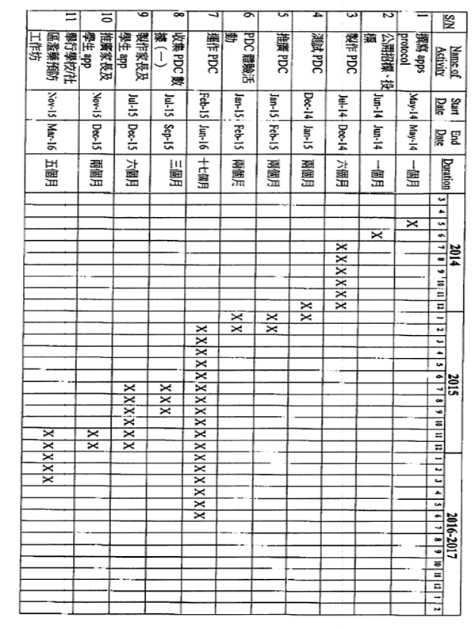
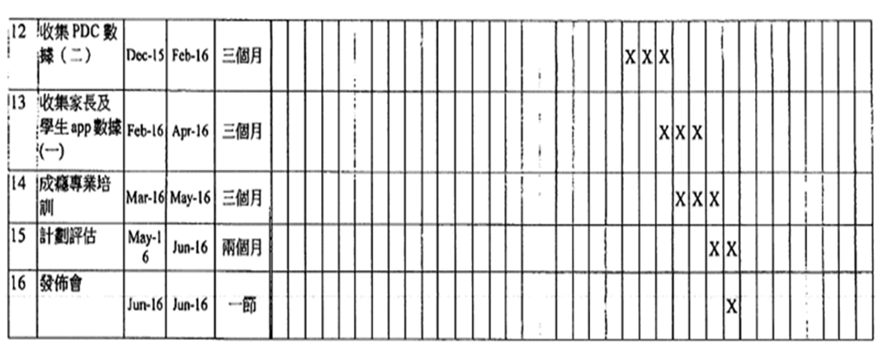

Slide 25
Marking Scheme

Slide 26
Enquiries
Mr. Toby Pang
Project Officer
Tel: 2446 9226
Email: chinghopang@elchk.org.hk
Ms Agnes Leung
Senior Social Worker Tel: 2446 9226
Email: agnesleung@elchk.org.hk
Notes:
*

Slide 27
Remarks
The contents in this set of PowerPoint are for reference only and do not have legal binding on the Invitation for Tendering for “Pocket Drug Counselor” Mobile Apps for Drug Rehabilitation (Version 2.0). In case of discrepancies, the recognized version should be referred to the one uploaded at the ELCHK Homepage.
投影片內容只作參考用途，並無法律約束力；有關邀請投標製作”Pocket Drug Counselor” Mobile Apps for Drug Rehabilitation (Version 2.0)，將以上載於基督教香港信義會社會服務部網頁之資料為準。

Slide 28
Q & A

Slide 29
Thank You

